Slide 1
Dear presenter,
This PowerPoint file is intended as a master presentation file from which you can form your own unique presentations. It is therefore not intended to be presented from beginning to end unless you find yourself in a very unique situation where doing so would be most beneficial for your specific audience.
When forming a unique presentation based on these slides, please consider such time-related factors as…
- your unique audience and their specific needs
- the level of influence you have with the specific group
- the time available (allowing time for questions - about one slide for every 5 minutes available)
- the distractions within the presentation environment
For your preparation, you will find The 3 Colors of Ministry book page references in the notes section on each slide.
Also, as part of your presentation, be prepared with your own personal stories from using The 3 Colors of Ministry.
Thanks for your important ministry.
Blessings
NCD International

Slide 2

Three ways to experience God
Creator
Spirit
Jesus
God
Notes:
Pages 10-11 of The 3 Colors of Ministry contain the teaching associated with this slide.

Slide 3

Goal: The Three-Color Christian
Calvary
soul
Christ
Creation
body
world
Pentecost
spirit
church
Three works of God
Three dimensions of life
Three conversions
scripture
evangelical
dogmatism
science
liberal
syncretism
experience
charismatic
spiritualism
Three authorities
Three tendencies
Three dangers
Notes:
Pages 12-14 of The 3 Colors of Ministry contain the teaching associated with this slide.

Slide 4

Goal: The Three-Color Christian
Notes:
Pages 12-14 of The 3 Colors of Ministry contain the teaching associated with this slide.

Slide 5
Three dimensions of ministry
There are different kinds of gifts,
but the same Spirit.
Spirit
gifts
power
There are different kinds of service,
but the same Lord.
Jesus
service
commitment
There are different kinds of working,
but the same God.
Creator
working
wisdom
Notes:
Pages 15-17 of The 3 Colors of Ministry contain the teaching associated with this slide.

Slide 6
Three dimensions of ministry
power
wisdom
commitment
Spirit
Jesus
Creator
God
Notes:
Pages 15-17 of The 3 Colors of Ministry contain the teaching associated with this slide.

Slide 7
Three dimensions of ministry
wisdom
working
gifts
service
power
commit-ment
Notes:
Pages 15-17 of The 3 Colors of Ministry contain the teaching associated with this slide.

Slide 8
Three dimensions of ministry
For this reason …
we have not stopped praying for you and asking God …
Prayer for:
… to fill you with the knowledge of his will through all spiritual wisdom and understanding …
wisdom
… that you may live a life worthy of the Lord and may please him in every way: bearing fruit in every good work, growing in the knowledge of God, …
commitment
… being strengthened with all power according to his glorious might.
power
Notes:
Pages 15-17 of The 3 Colors of Ministry contain the teaching associated with this slide.

Slide 9

Starting point 1: Thomas
wisdom
power
commitment
Notes:
Pages 22-23 of The 3 Colors of Ministry contain the teaching associated with this slide.

Slide 10
Starting point 2: Martha
wisdom
power
commitment
Notes:
Pages 24-25 of The 3 Colors of Ministry contain the teaching associated with this slide.

Slide 11
Starting point 3: Mary
wisdom
power
commitment
Notes:
Pages 26-27 of The 3 Colors of Ministry contain the teaching associated with this slide.

Slide 12
Starting point 4: Moses
wisdom
power
commitment
Notes:
Pages 28-29 of The 3 Colors of Ministry contain the teaching associated with this slide.

Slide 13
Starting point 5: Peter
wisdom
power
commitment
Notes:
Pages 30-31 of The 3 Colors of Ministry contain the teaching associated with this slide.

Slide 14
Starting point 6: Jonah
wisdom
power
commitment
Notes:
Pages 32-33 of The 3 Colors of Ministry contain the teaching associated with this slide.

Slide 15
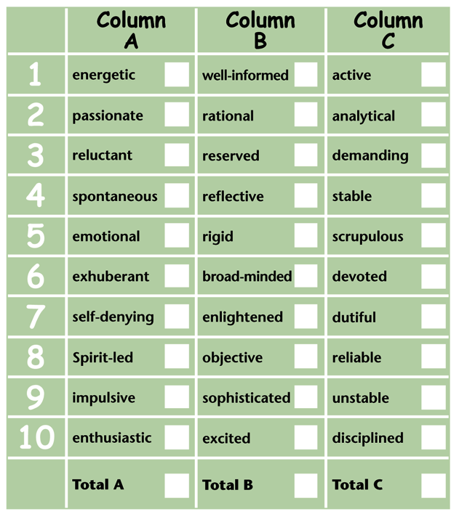
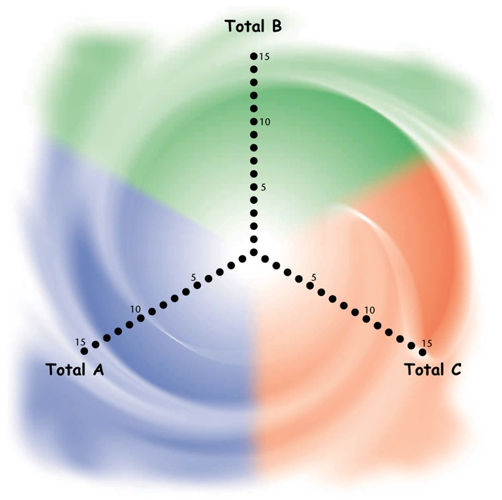
Your personal change compass
Notes:
Pages 34-37 of The 3 Colors of Ministry contain the teaching associated with this slide.

Slide 16
What does your own change compass look like?
Starting point 1:
Thomas
Starting point 2:
Moses
Starting point 3:
Martha
Starting point 4:
Peter
Starting point 5:
Mary
Starting point 6:
Jonah
Notes:
Pages 34-37 of The 3 Colors of Ministry contain the teaching associated with this slide.

Slide 17
Three different categories of gifts
Green
segment
Red
segment
Blue
segment
Biblical
paradigm
Creation
Calvary
Pentecost
Key
term
work
word
wonder
Primary
focus
world
Christ
church
Receptive
group
liberals
evangelicals
charismatics
Notes:
Pages 52-53 of The 3 Colors of Ministry contain the teaching associated with this slide.

Slide 18

The green gifts
The gifts listed in the green category relate primarily – but not exclusively – to God’s revelation in creation. That is the major reason why they can be found outside the Christian context as well. However, they become “spiritual” gifts at the moment we apply them to tasks that serve the kingdom of God.
One sub-category of these gifts relates primarily to developing life-giving environments:
Giving
Hospitality
Mercy
Voluntary Poverty
The gifts listed in the green category relate primarily to God’s revelation in creation.
A second sub-category addresses the area of developing ideas and systems:
Knowledge
Organization
Wisdom
A third sub-category relates to
developing things of purpose and beauty:
Artistic creativity
Craftsmanship
Music
Notes:
Page 102 of The 3 Colors of Ministry contains the teaching associated with this slide.

Slide 19

The red gifts
The gifts listed in the red category relate to proclaiming the gospel and helping people grow in their knowledge of Christ. That is the major reason why you will find in this category those gifts that enable us to fulfill various leadership roles in the church.
One sub-category of these gifts relates to sharing the good news:
Evangelism
Missionary
The gifts listed in the red category relate to proclaiming the gospel and helping people grow in their knowledge of Christ.
A second sub-category encompasses gifts for sharing the way forward:
Apostle
Counseling
Leadership
Shepherding
Teaching
A third sub-category can be used for sharing the load:
Helps
Service
Singleness
Notes:
Page 113 of The 3 Colors of Ministry contains the teaching associated with this slide.

Slide 20

The blue gifts
The gifts listed in the blue category demonstrate the power of God. Many of them transcend the limits of rationality in order to show God’s power over nature and to minister to people whose needs could not be met by conventional means.
One sub-category of the blue gifts relate to renewing trust in God:
Faith
Prayer
Suffering
The gifts in the
blue category demonstrate the supernatural working of God.
A second sub-category are for the purpose of renewing connections with God:
Discernment
Interpretation
Prophecy
Tongues
A third sub-category lead to
renewing through the power of God:
Deliverance
Healing
Miracles
Notes:
Page 124 of The 3 Colors of Ministry contains the teaching associated with this slide.

Slide 21
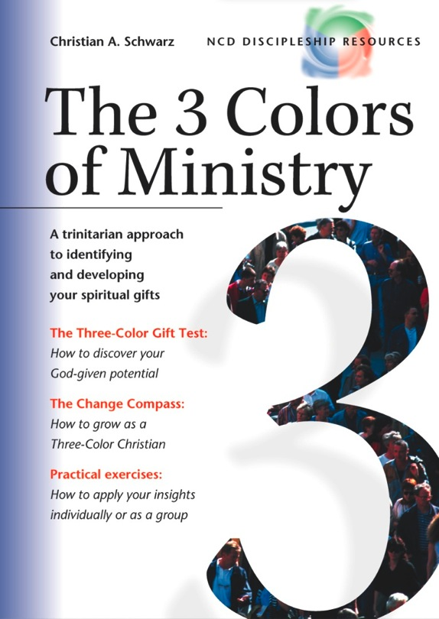
Small group and larger group volume discounts apply on the book.
Or you can get started straight away by taking the online eTest.
See the web site for details.
Notes:
The cover of The 3 Colors of Ministry.

Slide 22






























Gift description index
Artistic Creativity
Apostle
Deliverance
Craftsmanship
Counseling
Discernment
Giving
Evangelism
Faith
Hospitality
Helps
Healing
Knowledge
Leadership
Interpretation
Mercy
Missionary
Miracles
Music
Service
Prayer
Organization
Shepherding
Prophecy
Voluntary Poverty
Singleness
Suffering
Wisdom
Teaching
Tongues

Slide 23

The gift of artistic creativity
The gift of artistic creativity appears in a great variety of forms such as dance, sculpture, pottery, pantomime, music, composition, and writing. In contrast to the gift of craftsmanship, the gift of artistic creativity focuses on the creative element. Whatever the medium used, it is only a means to the end of expressing a specific idea or feeling.
Scripture references
Exodus 31:1-11, 2 Samuel 6:12-16, 1 Kings 7:14
Possible tasks
Layout of church publications, pantomime, developing public relations materials, web development, new forms of worship, arts and crafts group, drama, video projects, interior decoration, lyrics, musical composition ...
Questions
Can you recall examples of how your own faith has been enriched through artistic creativity (painting, music, prose, etc.)?
To what extent is it possible to exercise this gift in your own church?
This gift enables you to use artistic expression for the edification of others.
Return to gift description index
Notes:
Page 103 of The 3 Colors of Ministry contains the teaching associated with this slide.

Slide 24

The gift of craftsmanship
The gift of craftsmanship can be used in a multitude of ways (gardening, building, car repair, as well as tasks that might be traditionally seen as “female” tasks, such as sewing, etc.). Observe, however, that not everyone who is skillful with his or her hands has this gift. People who don‘t have this gift might love crafts, but they don‘t experience the overwhelming joy that arises from exercising their gift for the benefit of others. This joy of ministering to others, however, is characteristic of those who have the spiritual gift of craftsmanship.
Scripture references
Exodus 30:22-31, 2 Kings 12:11-13, 2 Chronicles 34:9-13, Acts 18:3
Possible tasks
Building, gardening, helping others with odd jobs in the neighborhood, maintenance, technical team, foreign missions, sewing projects ...
Questions
Should your church exclusively call upon church members with this gift, or should it also contract professionals from outside the church?
Which Christians do you know with this gift? Do they understand their skill as being a spiritual gift? How are they using it to build up the body of Christ?
This gift enables you to use a trade or craft for the good of the body of Christ.
Return to gift description index
Notes:
Page 104 of The 3 Colors of Ministry contains the teaching associated with this slide.

Slide 25

The gift of giving
You don‘t need a special gift to tithe regularly. There are individuals, however, that give a significant percentage beyond their tithe to the kingdom of God. The gift of giving is not to be confused with the gift of voluntary poverty (see page 111), even if these two frequently appear together in one’s gift mix.
Scripture references
Luke 3:11, Luke 21:1-4, John 12:3-8, Acts 4:32-37, Acts 20:35, Romans 12:8, 2 Corinthians 8:2-5
Possible tasks
Finance committee member, supporting missionaries, treasurer, full-time financial adviser, tithe coordinator, assisting in crises, supporting special projects ...
Questions
Have you ever experienced God’s special blessing as a result of some gift you gave? Did this experience motivate you to give more? If so, how?
List additional projects that your church could take on if every Chris- tian tithed and every person with the gift of giving (our research indicates that this is approximately 14 percent in most Christian groups) applied this gift.
This gift enables you to give material things cheerfully and generously to others.
Return to gift description index
Notes:
Page 105 of The 3 Colors of Ministry contains the teaching associated with this slide.

Slide 26

The gift of hospitality
People with the gift of hospitality are usually happier when they have guests than when they don‘t. Please note that it is not a prerequisite that you possess this gift to maintain an open home and be friendly to visitors. Hospitality is to be exercised by all Christians as one of the universal Christian responsibilities (see page 48). Those with this gift, however, are able to make their guests really feel at home. Most of them can create this atmosphere even outside their own homes.
Scripture references
Genesis 18:1-8, Matthew 10:11-14 and 40, Matthew 25:35, Luke 10:38-42, Romans 12:9-13, Titus 1:7-8, 1 Peter 4:9-10, Hebrews 13:1-2, 3 John 5-10
Possible tasks
Small group host, caring for the homeless, worship service greeter, ministry to the underprivileged, retreat leadership, church exchanges, hosting guests, preparing accommodations for groups, youth ministry ...
Questions
Have you ever been hosted by someone with this gift? Describe how you felt.
Which of the following gifts do you regard as contributing most to church development: hospitality, tongues, shepherding, or teaching? Explain your answer.
This gift enables you to maintain an open home, offering food and lodging to guests.
Return to gift description index
Notes:
Page 106 of The 3 Colors of Ministry contains the teaching associated with this slide.

Slide 27

The gift of knowledge
Christians differ in their understanding of the gift of knowledge. Some understand knowledge (and wisdom) to be supernatural insight into specific situations. This phenomenon certainly exists, but in this book it is addressed under the gift of prophecy (see page 132). Christians with the gift of knowledge develop new ideas that are valuable for the church. Sixty-six percent of those with the gift of knowledge also have the gift of teaching—a particularly useful gift mix.
Scripture references
Romans 15:14, 1 Corinthians 8:1-2, 1 Corinthians 12:8, 1 Corinthians 13:2 and 8-10, 2 Corinthians 12:7, Ephesians 3:14-19
Possible tasks
Church growth research, seminar preparation, writing, long-term planning, Bible study, journalism, theological studies, academic work, creative evangelistic outreach ...
Questions
Whom do you know with the gift of knowledge? Are they using their gift for church development? In what ways?
Do those with the gift of knowledge derive their insights from natural or supernatural sources? Are both sources valid for the church? Explain.
This gift enables you to generate, collect, and analyze ideas which are important for the health of the church.
Return to gift description index
Notes:
Page 107 of The 3 Colors of Ministry contains the teaching associated with this slide.

Slide 28

The gift of mercy
The gift of mercy can be distinguished from the gift of helps or service in that it typically reaches out to those on the perimeter of society. While Christians with the gift of counseling minister primarily through loving words, those with the gift of mercy seek to meet the needs of others through loving action. In many cases, this gift is still undiscovered. Our research indicates that 13 percent of all Christians have the gift of mercy as a part of their gift mix.
Scripture references
Matthew 25:37-40, Mark 9:41, Luke 10:33-37, Acts 9:36-42, Romans 12:4-8, James 1:27, James 2:14-17
Possible tasks
Counseling sessions, intercessory prayer, ministry to the underprivileged, prison ministry, foreign missions, ministry to single mothers/fathers, ministry to the handicapped, hospital/sick calls, ministry to the chemically dependent ...
Questions
What is the difference between the gift of mercy and the corresponding universal Christian responsibility (see page 48)? Consider several situations in which every Christian should practice mercy and several that are particularly for those with the gift of mercy.
How do people demonstrate that they have this gift? Record several distinctive characteristics.
This gift enables you to demonstrate empathy through practical deeds toward those who are troubled in mind, body, or spirit.
Return to gift description index
Notes:
Page 108 of The 3 Colors of Ministry contains the teaching associated with this slide.

Slide 29

The gift of music
The gift of music doesn‘t involve composing music or writing lyrics (that ability belongs to artistic creativity), but rather singing and playing music itself. The Old Testament mentions a variety of roles that apply to this gift: instrumentalists (1 Chron. 15:20f; 2 Chron. 29:26), vocalists (1 Chron. 15:19), worship leaders (Neh. 12:46), and choir directors (1 Chron. 15:22).
Scripture references
Deuteronomy 31:14-23, 1 Samuel 16:14-23, 1 Chronicles 16:41-42, 2 Chronicles 5:12-14, Psalm 150, 1 Corinthians 14:26, Ephesians 5:18-20, Colossians 3:15-17
Possible tasks
Worship leader, instrumentalist, music teacher, worship team, street outreach, choir director, choir member, planning worship services, vocal soloist, evangelistic outreach ...
Questions
Is the gift of music a precondition for singing in the choir? Why, or why not?
Does someone with this gift need to practice more, or less than someone without it? Why?
This gift enables you to play a musical instrument or to use your voice in singing for the glory of God and the edification of others.
Return to gift description index
Notes:
Page 109 of The 3 Colors of Ministry contains the teaching associated with this slide.

Slide 30

The gift of organization
The Greek word for “organizer” can also be translated “steerer,” the person on a ship whose job it is to mediate between the captain and the rest of the crew. The difference between the gift of leadership and the gift of organization relates to the difference between the captain and the steerer of a ship. The captain makes the basic decisions regarding the route of the ship, and the helmsman guides the ship safely to her intended destination.
Scripture references
Exodus 18:13-27, 1 Corinthians 12:28
Possible tasks
Area superintendent, overseer of ministry area(s), church growth planning, organization of events (such as workshops, conferences, concerts), finances, church celebrations, evangelistic campaigns, coordination of small groups, librarian, leadership in ministry teams, creative worship forms, project planning, preparing church retreats, computer work ...
Questions
Which tasks in your church could be carried out more effectively if people with this gift were to get involved?
What, if anything, stands in the way of delegating these tasks to someone with the gift of organization?
This gift enables you to understand goals for specific areas of ministry and to draft effective plans toward reaching these goals.
Return to gift description index
Notes:
Page 110 of The 3 Colors of Ministry contains the teaching associated with this slide.

Slide 31

The gift of voluntary poverty
In our understanding of the gift of voluntary poverty, the word “voluntary” is essential. Not everyone with a modest lifestyle has this gift. Rather, the gift of voluntary poverty is exercised by those who could maintain a higher standard of living but consciously choose not to. Don‘t confuse this gift with that of “giving.” It is true that almost everyone who has the gift of voluntary poverty also has the gift of giving (92 percent have “giving” among their five most prominent manifest gifts). The inverse is not true, however. Our research states that only 15 percent of the Christians with the gift of giving also have the gift of voluntary poverty.
Scripture references
Acts 2:44-45, Acts 4:32-37, 1 Corinthians 13:3, 2 Corinthi- ans 6:10, Philippians 4:11-13
Possible tasks
Foreign missions, ministry to the underprivileged, ministry to the homeless and refugees, community outreach, living in a monastery, pioneer work …
Questions
Reflect on the life of someone like Mother Teresa. Do you think that this lifestyle is a great personal sacrifice for that person? Or do you think that perhaps he or she is happier living that way?
Should every Christian lead a simple lifestyle, or only those who have this gift?
This gift enables you to deny yourself material well-being so that you can maintain a standard of living that parallels the poor.
Return to gift description index
Notes:
Page 111 of The 3 Colors of Ministry contains the teaching associated with this slide.

Slide 32

The gift of wisdom
The gift of wisdom is to be distinguished from the gift of knowledge. Those with the gift of knowledge treat spiritual matters like a medical researcher who seeks to gain insight into physiology, genetics, or the effect of a vaccine through his or her lab work. Those with the gift of wisdom, on the other hand, can be compared to a physician who offers a diagnosis and applies the medical research to each individual case. Caution: Some Christians refer to a “word of wisdom” when they really mean a prophetic utterance (see page 132).
Scripture references
1 Kings 3:5-28, 1 Corinthians 12:7-8, James 3:13-18
Possible tasks
Counseling, conflict resolution, prayer team, career consulting, training courses, gift consulting, seminars, coaching, online forums, church consulting ...
Questions
When have you personally benefited from people that have this gift? Record the details of this experience.
Would it be valuable for your church to seek out a church consultant? Write down the advantages and disadvantages.
This gift enables you to help others apply existing knowledge to specific situations.
Return to gift description index
Notes:
Page 112 of The 3 Colors of Ministry contains the teaching associated with this slide.

Slide 33

The gift of apostle
The gift of apostle is by no means limited to the original twelve apostles. The New Testament offers examples of other men and women in apostolic ministry. An apostle‘s responsibility typically extends beyond his or her own local church. Their authority is independent of any office they may hold. People with this gift distinguish themselves through their farsighted perspective.
Scripture references
Matthew 10:2-15, John 13:12-17, Acts 8:14-25, Acts 14:14- 15, Acts 15:1-6, Romans 16:7, 1 Corinthians 12:28-29, 2 Corinthians 12:12, Galatians 1:1, Ephesians 4:11
Possible tasks
Church planting, church consulting, long-term planning, regional/denominational responsibilities, interdenominational work, foreign missions ...
Questions
Does each regional or national church leader (e.g., bishop, superin- tendent, etc.) have to have an apostolic gift? Why, or why not?
In your opinion, do the regional leaders of your church have an apostolic gift? Explain.
This gift enables you to be recognized as a spiritual leader by a variety of churches.
Return to gift description index
Notes:
Page 114 of The 3 Colors of Ministry contains the teaching associated with this slide.

Slide 34

The gift of counseling
The gift of counseling tries to combine the two dimensions of the Greek word parakaleo which can mean both “admonition” and “encouragement.” This gift is different from the gift of shepherding in that the ministry of counseling doesn‘t require a long-term relationship with the people who receive the ministry. Those with this gift only use it for a limited time period while seeking the personal and spiritual well-being of another. Then they apply this gift in a different situation with a different person. It‘s interesting to note that 41 percent of Christians who have this gift also have the gift of hospitality.
Scripture references
John 4:1-42, Acts 14:21-22, Romans 12:6-8, 2 Corinthians 1:3-7, 1 Thessalonians 2:11, 1 Thessalonians 5:14, 1 Timothy 5:1
Possible tasks
Integrating new Christians, hospital ministry, counseling team, small group ministry, gift consulting, prayer team, challenging passive Christians, substance abuse counseling, ministry to the underprivileged, family counseling, seniors ministry, telephone counseling, internet forums, supervision, prison ministry, hospice ministry ...
Questions
Does every Christian who wants to counsel need training in psychology? Why, or why not?
This gift enables you to serve others through comfort, admonition, and encouragement, so that they experience help and healing.
Return to gift description index
Notes:
Page 115 of The 3 Colors of Ministry contains the teaching associated with this slide.

Slide 35

The gift of evangelism
Our research confirmed the thesis held by C. Peter Wagner that exactly 10 percent of the Christians in each local congregation have the gift of evangelism. Christians who discover this gift should be given enough time to exercise it and, in most cases, should be released from other tasks.
Scripture references
Acts 8:5-6, Acts 8:26-40, Acts 14:13-21, Romans 10:14-15, Ephesians 4:11
Possible tasks
Preaching, open houses, visitation ministry, counseling, radio ministry, internet forums, foreign missions, church planting team, ministry to the underprivileged, evangelistic home groups, music or band ministry, children’s evangelism, ministry to internationals ...
Questions
As you reflect on how you came to faith, which person(s) had the greatest influence on your decision? Why?
Do you think that they had the gift of evangelism? What makes you think so?
This gift enables you to communicate the gospel to non-Christians in a manner conductive to leading them to faith.
Return to gift description index
Notes:
Page 116 of The 3 Colors of Ministry contains the teaching associated with this slide.

Slide 36

The gift of helps
The gift of helps, like the gift of mercy, focuses on individuals. In contrast to the gift of mercy, however, this gift is not so much intended for the benefit of the underprivileged. Rather, it is more commonly used to lighten the work load of other Christians (most frequently leaders), allowing them more time to exercise their own gifts. The gift of helps should also be distinguished from the gift of service. Service aims at serving organizations; helps aims at helping individuals.
Scripture references
Exodus 18:21-22, Numbers 11:16-17, Luke 10:38-42, Romans 16:1-2, 1 Corinthians 12:28
Possible tasks
Telephone ministry, supporting leaders, secretarial help, helping families move into new homes, web support, custodial service ...
Questions
In what way could the leaders of your church be aided if the gift of helps was consistently exercised?
According to our research, 13 percent of all Christians have the gift of helps. Do the Christians in your church who have this gift know that it is a spiritual gift?
This gift enables you to place your own gifts at the disposal of other people, thus releasing them to concentrate more on their ministry.
Return to gift description index
Notes:
Page 117 of The 3 Colors of Ministry contains the teaching associated with this slide.

Slide 37

The gift of leadership
The trademark of a leader is that others follow him or her of their own free will rather than by coercion. Christians with this gift usually don‘t have to stress their “leadership authority” (in most cases, this is an indica- tion that one does not have this gift). It is interesting that 68 percent of all Christians with this gift also have the gift of organization.
Scripture references
Exodus 18:13-27, Romans 12:8, 1 Thessalonians 5:12-13, 1 Timothy 3:1-7, 1 Timothy 5:17-22
Possible tasks
Pastor, elder, worship service leader, department leader, long-term planning, church planting, pioneer work, initiating new ministries ...
Questions
Consider those in your church in leadership positions. Do these individuals have the gift of leadership? How can you tell?
Reflect on others you may know who possess this gift. Which gifts are frequently combined with the gift of leadership?
This gift enables you to set goals for the church and to communicate them in such a way that others volunteer to achieve them.
Return to gift description index
Notes:
Page 118 of The 3 Colors of Ministry contains the teaching associated with this slide.

Slide 38

The gift of missionary
Christians with the gift of missionary enjoy leaving their own culture in order to establish a new home and ministry in a foreign culture. This gift can be exercised in a foreign country, as well as within a different social group in their home country. The gift of missionary should not be confused with the gift of evangelism (see page 116). Only 8 percent of all Christians whom God has blessed with the gift of missionary have the gift of evangelism too.
Scripture references
Acts 9:13-17, Acts 14:21-28, 1 Corinthians 9:19-23, Galatians 1:15-17, Galatians 2:7-14, Ephesians 3:6-8
Possible tasks
Ministry to the underprivileged, ministry to internationals, foreign missions, church planting, intercultural dialogue, ministry to specific target groups ...
Questions
What exactly is the difference between the gift of missionary and the gift of evangelism?
“Everyone should become a foreign missionary if God has not called them to stay home.” What do you think of this statement?
This gift enables you to utilize your other gifts in a second culture.
Return to gift description index
Notes:
Page 119 of The 3 Colors of Ministry contains the teaching associated with this slide.

Slide 39

The gift of service
In contrast to the gift of helps, which usually focuses on assisting an individual (very often a leader), the gift of service is directed toward groups and organizations. Christians with the gift of service typically have an eye for things that need to be done, and they are willing to fulfill that need themselves. Every group benefits from Christians who exercise this gift. The gifts of service and helps are among the gifts that are most frequently paired together. According to our research, 81 percent of Christians who have the gift of service also have the gift of helps.
Scripture references
Luke 10:38-42, Luke 22:24-27, Acts 6:1-7, Romans 12:6-7, 1 Timothy 3:8-13
Possible tasks
Odd jobs, gardening, caring for guests, cooking and baking, maintenance, typing/computer work, tape ministry, baby-sitting, emergency ministry ...
Questions
Which tasks in your church could be carried out more successfully if those with the gift of service were actively applying their gifts?
What obstacles in your church are hindering those with this gift from consistently exercising it?
This gift enables you to recognize where your participation is needed and to make sure that the most urgent jobs gets done.
Return to gift description index
Notes:
Page 120 of The 3 Colors of Ministry contains the teaching associated with this slide.

Slide 40

The gift of shepherding
The gift of shepherding—in contrast to the gift of counseling —involves a long-term commitment to a group of fellow Christians. Contrary to widespread opinion, this gift is not necessary for a pastor of a local church. Our research indicates that the gift of shepherding is relatively widespread, appearing in 12 percent of the gift mixes of all Christians. Interestingly, 43 percent of all Christians with the gift of shepherding also have the gift of teaching.
Scripture references
John 10:1-15, Acts 20:28-31, Ephesians 4:11, 1 Thessalonians 5:12-13, 1 Timothy 4:11-16, Hebrews 13:7,17 and 20-21, 1 Peter 5:1-5
Possible tasks
Gift consultant, children’s church, small group leader, youth ministry, assimilating new Christians, informal gatherings, training programs ...
Questions
Twelve percent of all Christians have this gift. Why do you think this gift is so prevalent?
Leading small groups is an ideal ministry for those who have this gift. In your opinion, do the small group leaders of your church have this gift? Are there individuals in your church with the gift of shep- herding who haven’t yet found any relevant tasks in which they can exercise this gift?
This gift enables you to assume long-term, personal responsibility for the spiritual well-being of a group of people.
Return to gift description index
Notes:
Page 121 of The 3 Colors of Ministry contains the teaching associated with this slide.

Slide 41

The gift of singleness
The gift of missionary and the gift of singleness are two gifts which, in contrast to all other gifts, can only be exercised meaningfully in combination with other gifts. In other words, they cannot stand on their own. Anyone with the gift of singleness will likely be able to exercise his or her other gifts more effectively. Those with this gift are happier in their singleness than they would be if they were married.
Scripture references
Matthew 19:10-12, 1 Corinthians 7:7-8, 1 Corinthians 7:32- 35, 1 Timothy 4:1-5
Possible tasks
Since the gift of singleness is intended to make other gifts more effective, it is theoretically possible to combine any task with it. However, those involved in foreign missions, church planting, and similar pioneer work may particularly profit from this gift since a great degree of flexibility is required in these ministries. This kind of flexibility is often difficult to harmonize with family concerns.
Questions
Do you regard the oath of celibacy in the Roman Catholic Church to be an appropriate means of exercising the gift of singleness? Why, or why not?
Is it necessary to have a specific spiritual gift to get married?
This gift enables you to live happily as a single while contributing more effectively to the kingdom of God.
Return to gift description index
Notes:
Page 122 of The 3 Colors of Ministry contains the teaching associated with this slide.

Slide 42

The gift of teaching
Characteristic of the gift of teaching is the fact that others actually learn. Just knowing a lot (which may be an indication of the gift of knowledge, see page 107), should not be confused with the gift of teaching. Those with the gift of teaching are focused on the questions and concerns of their audience, and manage to impart their knowledge in an interesting and stimulating manner.
Scripture references
Acts 18:24-28, Romans 12:6-7, 1 Corinthians 12:28-29, Ephesians 4:11-14, James 3:1
Possible tasks
Small group ministry, seminars, training courses, Bible studies, new members/baptism class, online work, church growth training ...
Questions
Why do you suppose the Bible suggests that teachers will be subject to more severe judgement?
Reflect on the various teachers, professors, and pastors that you know. Which of them has the gift of teaching? How can you see this gift in their lives?
This gift enables you to communicate truth in a manner that enables others to learn and contributes to the health of the church.
Return to gift description index
Notes:
Page 123 of The 3 Colors of Ministry contains the teaching associated with this slide.

Slide 43

The gift of deliverance
Power over evil spirits is given to each Christian (Mark 16:15-18). Yet, experience indicates that God uses some Christians more than others in exercising this power. The gift of discernment (see page 126) should be present in any group that is involved in a ministry of deliverance.
Scripture references
Matthew 10:1, Matthew 12:28-29 and 43-45, Mark 5:1-20, Mark 9:28-29, Mark 16:17, Luke 10:17-20, Acts 8:5-8, Acts 16:16-18, Acts 19:13-16
Possible tasks
Exorcism, ministry to the underprivileged, prayer team ministry, counseling, evangelistic events, foreign missions ...
Questions
Are you convinced that there are demons active in the world today? Why? Have you ever experienced the influence of demons in any perceptible manner?
Is it possible for Christians to be oppressed by demons? Why, or why not?
This gift enables you to help people suffering from demonic oppression experience deliverance.
Return to gift description index
Notes:
Page 125 of The 3 Colors of Ministry contains the teaching associated with this slide.

Slide 44

The gift of discernment
The gift of discernment is part of God’s providential protection against error. It can express itself on a natural level by enabling Christians to distinguish between truth and deception. It can also provide them with insight into the deepest sources of truth and deception, thus entering into the supernatural realm.
Scripture references
Matthew 16:22-23, Acts 5:1-10, Acts 8:18-24, Acts 13:6-12, Acts 16:16-22, 1 Corinthians 12:10, 1 Thessalonians 5:19- 22, 1 John 4:1-6
Possible tasks
Public relations, counseling, deliverance ministry, ministry to the underprivileged, church board member, evangelistic campaigns, preaching, prayer team ministry, long-term planning, interreligious dialogue ...
Questions
Suppose someone were to stand up in your worship service and exclaim, “This part of the sermon is inconsistent with the Word of God!” What would happen?
How and when is this gift used in your church?
This gift enables you to know for sure whether a given behavior originates from a divine, human or satanic source.
Return to gift description index
Notes:
Page 126 of The 3 Colors of Ministry contains the teaching associated with this slide.

Slide 45

The gift of faith
While it is every Christian’s calling to trust the Lord in all of life’s challenges, God has blessed some people with a special gift of faith. These individuals
literally have a “mountain-moving” faith (Matt. 17:20). They don‘t shy away from uncertainties and risks when they are convinced of the will of God. People with this gift are often visionaries who initiate new developments.
Scripture references
Matthew 8:5-13, Matthew 17:20b, Matthew 21:18-22, Romans 4:18-21, 1 Corinthians 12:9, James 1:5-8
Possible tasks
Prayer group leader, church board member, long-term planning, church planting, creative ideas team, denominational leadership, church leadership for missions, pioneer work, initiating new ministries, evangelism ...
Questions
Whom do you know with this gift? Do they motivate or frustrate you when you are around them?
Those with this gift are often considered “dreamers.” Would you say it is advisable to appoint such people to leadership positions? Do some of the leaders of your church have this gift?
This gift enables you to discern, with an unusual degree of confidence, the will of God for the future development of ministry.
Return to gift description index
Notes:
Page 127 of The 3 Colors of Ministry contains the teaching associated with this slide.

Slide 46

The gift of healing
While the New Testament admonishes all believers to pray for the sick (Mark 16:18), God has given some people the special gift of healing. It is always
God who does the healing; men and women can only pray to this end. The gift of healing can appear in different variations (see page 46). There are certain individuals, for example, that God uses to heal wounds of the soul (“inner healing”).
Scripture references
Mark 2:1-12, Mark 8:22-26, Mark 16:17-18, John 9:1- 12, John 14:12-14, Acts 3:1-8, Acts 14:8-15, Acts 28:8-9, 1 Corinthians 12:9 and 28-30, James 5:14-15
Possible tasks
Counseling, prayer team, evangelism team, visiting the sick ...
Questions
Are you aware of any supernatural healings in your own circle of friends and acquaintances? Did you react with joy or skepticism at the news of healing?
Are you aware of cases in which certain persons were not healed, despite long periods of prayer? How do you interpret these situations?
This gift enables you to serve as God’s instruments for restoring the health of others without the aid of medical tools.
Return to gift description index
Notes:
Page 128 of The 3 Colors of Ministry contains the teaching associated with this slide.

Slide 47

The gift of interpretation
Some Christians with the gift of interpretation interpret the messages that another person has given in tongues; some interpret their own statements. According to the New Testament, a public message in tongues is meaningless without the corresponding interpretation (1 Cor. 14:27-28). Our research indicates that 82 percent of all Christians with this gift also have the gift of prophecy.
Scripture references
1 Corinthians 12:10, 1 Corinthians 12:27-31, 1 Corinthians 14:1-5, 1 Corinthians 14:12-19, 1 Corinthians 14:26-28
Possible tasks
Prayer groups, worship service team, spiritual warfare …
Questions
According to the Bible, must an interpretation be provided every time someone speaks in tongues?
In your opinion, why is it that this gift is used in some churches and not in others?
This gift enables you to make known in a commonly understood language a message originally communicated in tongues.
Return to gift description index
Notes:
Page 129 of The 3 Colors of Ministry contains the teaching associated with this slide.

Slide 48

The gift of miracles
Whereas the gift of healing might not necessarily break physical laws (the focus is just that healing takes place without the use of medical tools), it is
characteristic of the gift of miracles that laws of nature are— in the eyes of the observer—surpassed. Wherever God works a miracle through this gift, it is his goal to communicate a specific message to his people.
Scripture references
Exodus 14:21-31, 1 Kings 18:21-40, Matthew 14:28-33, Matthew 24:23-24, Luke 10:17-20, John 14:2-14, Acts 9:36- 42, Acts 19:11, Acts 20:9-12, Romans 15:18-19, 1 Corinthians 12:10 and 28, 2 Corinthians 12:12
Possible tasks
Foreign missions, spiritual warfare, prayer ministry ...
Questions
What is the difference between the gift of miracles and the gift of healing?
Have you ever observed a concrete example of this gift being exercised? If so, what effect did it have on you?
This gift enables you to serve as a human instrument through whom God performs powerful acts that surpass natural laws.
Return to gift description index
Notes:
Page 130 of The 3 Colors of Ministry contains the teaching associated with this slide.

Slide 49

The gift of prayer
The gift of prayer belongs to those gifts that the Bible does not explicitly label as “spiritual gifts.” Yet, experience demonstrates that there are Christians who have a unique power in prayer. While it is every Christian’s privilege and duty to pray, those with this gift are able to spend many hours praying intensively, and they enjoy every minute of it.
Scripture references
Daniel 6:11-12, Daniel 9:1-4, Luke 11:1-13, Acts 16:19-34, Colossians 4:12-13, 1 Timothy 2:1-4, James 5:16-18
Possible tasks
Prayer groups, leading prayer vigils, spiritual warfare, prayer chains, intercession for specific requests, prayer ministry at specific events ...
Questions
Do you regard prayer to be work, or is it rather relaxing for you? Describe the feelings you had during your last extended prayer time.
When you hear of people who spend many hours a day in prayer, do you react more positively, or negatively? Why?
This gift enables you to pray for concrete requests over long periods of time, and to receive visible answers far more frequently than most people.
Return to gift description index
Notes:
Page 131 of The 3 Colors of Ministry contains the teaching associated with this slide.

Slide 50

The gift of prophecy
In contrast to common usage, the gift of prophecy does not only refer to the foretelling of future events. Instead, it enables people to serve as the vehicle for a divine message regarding a concrete situation. Please notice that some Christians use terms like “word of knowledge,” “word of wisdom”, “image,” or “vision” for what is referred to here as the gift of prophecy.
Scripture references
Deuteronomy 13:1-5, Deuteronomy 18:18-22, 1 Samuel 3:1-21, Matthew 7:15-20, Matthew 24:11 and 23-24, Acts 15:32, 1 Corinthians 12:28-29, 1 Corinthians 14:3 and 22-40, 2 Peter 1:19-21, 1 John 4:1-6, Revelation 1:1-3
Possible tasks
Foreign missions, evangelistic events, long-term planning, outreach to the underprivileged, worship team, prayer team, small groups, counseling, prayer chains …
Questions
What do you think of the following thesis: “Whenever our pastor preaches on Sunday morning, the gift or prophecy is being practiced”?
Some Christians make the following assertion: “Since the completion of the New Testament, there is no longer any need for the gift of prophecy; and, as a result, it no longer exists.” How do you react to this statement?
This gift enables you to receive a message from God by the Holy Spirit and to communicate it to other people.
Return to gift description index
Notes:
Page 132 of The 3 Colors of Ministry contains the teaching associated with this slide.

Slide 51

The gift of suffering
The gift of suffering involves more than just a willingness to follow Christ to the point of death, although this may be included. While every believer experiences pain and suffering at times, God endows certain Christians with a special ability to maintain a victorious mindset, even in the midst of intense suffering. The familiar phrase “the blood of the martyrs is the seed of the church” expresses well the relationship between this spiritual gift and church growth.
Scripture references
Matthew 5:10-12, Acts 7:54-60, Acts 8:1-4, Acts 20:22-24, Acts 21:4-14, 1 Corinthians 13:1-3, 2 Corinthians 1:8-11, 2 Corinthians 11:21b-33, 2 Corinthians 12:9-10, Philippians 1:12-14, 1 Peter 2:20-25, 1 Peter 4:12-16
Possible tasks
Intercession, foreign missions, pioneer ministry ...
Questions
The Greek word martys can be translated either “martyr” or “wit- ness.” What is the relationship between these two words?
Do you know any Christians whose suffering has strengthened your own faith?
This gift enables you to suffer for your faith while at the same time maintaining a joyful, victorious spirit.
Return to gift description index
Notes:
Page 133 of The 3 Colors of Ministry contains the teaching associated with this slide.

Slide 52

The gift of tongues
The gift of tongues comes in two different variations, either as personal prayer or as a public utterance. The second variation should only be exercised with an interpreter (1 Cor. 14:27-28). Caution: In the Three-Color Gift Test, the gift of tongues is treated in the same way as all of the other gifts. Christians who only occasionally pray in tongues will probably not find tongues among their manifest gifts. It will only occur as a manifest gift if speaking in tongues is a significant part of one’s spiritual life.
Scripture references
Mark 16:17, Acts 2:1-13, Acts 10:44-48, Acts 19:1-7, Romans 8:26-27, 1 Corinthians 12:10 and 28-30, 1 Corinthians 14:4-6 and 26-28
Possible tasks
Prayer ministry, spiritual warfare ...
Questions
In your opinion, why do some Christians insist that the gift of tongues doesn‘t exist today?
Could the gift of tongues be useful in your own spiritual life?
This gift enables you to use a language you have never learned, either in your personal prayer times or for a public message.
Return to gift description index
Notes:
Page 134 of The 3 Colors of Ministry contains the teaching associated with this slide.

