Slide 1
Dear presenter,
This PowerPoint file is intended as a master presentation file from which you can form your own unique presentations. It is therefore not intended to be presented from beginning to end unless you find yourself in a very unique situation where doing so would be most beneficial for your specific audience.
When forming a unique presentation based on these slides, please consider such time-related factors as…
- your unique audience and their specific needs
- the level of influence you have with the specific group
- the time available (allowing time for questions - about one slide for every 5 minutes available)
- the distractions within the presentation environment
For your preparation, you will find The 3 Colors of Leadership book page references in the notes section on each slide.
Also, as part of your presentation, be prepared with your own personal stories from using The 3 Colors of Leadership.
Thanks for your important ministry.
Blessings
NCD International

Slide 2

The focus of the
Empowerment Test
Notes:
Pages 10-13 of The 3 Colors of Leadership contain the teaching associated with this slide.

Slide 3
Empowering—or only powerful?
“I lead”
C
D
“I don’t
empower”
“I empower”
A
B
“I don’t lead”
Notes:
Pages 14-17 of The 3 Colors of Leadership contain the teaching associated with this slide.

Slide 4
Empowering—or only powerful?
“I lead”
C
D
“I don’t
empower”
“I empower”
A
B
“I don’t lead”
Notes:
Pages 14-17 of The 3 Colors of Leadership contain the teaching associated with this slide.

Slide 5
Empowering—or only powerful?
“I lead”
C
D
“I don’t
empower”
“I empower”
A
B
“I don’t lead”
Notes:
Pages 14-17 of The 3 Colors of Leadership contain the teaching associated with this slide.

Slide 6
Empowering—or only powerful?
“I lead”
C
D
“I don’t
empower”
“I empower”
A
B
“I don’t lead”
Notes:
Pages 14-17 of The 3 Colors of Leadership contain the teaching associated with this slide.

Slide 7
Empowering—or only powerful?
“I lead”
C
D
“I don’t
empower”
“I empower”
A
B
“I don’t lead”
Notes:
Pages 14-17 of The 3 Colors of Leadership contain the teaching associated with this slide.

Slide 8
A radical change of perspective
Measures to achieve
a result
Results
money (amount)
workers (number)
infrastructure (size)
A
B
Mature people who have discovered and live out their own visions
Notes:
Pages 18-20 of The 3 Colors of Leadership contain the teaching associated with this slide.

Slide 9


The three dimensions of leadership
liberation
motivation
explanation
Teach the principles
Permit mistakes
Focus on strengths
Notes:
Pages 21-25 of The 3 Colors of Leadership contain the teaching associated with this slide.

Slide 10
Three misdirected roles
liberation
motivation
explanation
misdirected role:
EXPERT
misdirected role:
COMRADE
misdirected role:
DRIVER
Notes:
Pages 21-25 of The 3 Colors of Leadership contain the teaching associated with this slide.

Slide 11

Wing traits needed
empowering wing
leading wing
liberation
motivation
explanation
Teach the principles
Analyze present situation
Nurture steady progress
Assess weaknesses
Learn from mistakes
Release vision of others
Cast a vision
Permit mistakes
Focus on strengths
Advocate bold moves
Set goals
Model the principles
Notes:
Pages 26-29 of The 3 Colors of Leadership contain the teaching associated with this slide.

Slide 12
Wing traits needed
Vision
Release vision of others
Cast a vision
Experimen-
tation
Permit mistakes
Learn from mistakes
Capacity
Assess weaknesses
Focus on strengths
Strategy
Analyze present situation
Set goals
Training
Teach the principles
Model the principles
Progression
Nurture steady progress
Advocate bold moves
Notes:
Pages 26-29 of The 3 Colors of Leadership contain the teaching associated with this slide.

Slide 13
The secret: character plus gifting plus training
plus
gifting
Effective
leadership
Character
plus
training
Notes:
Pages 30-32 of The 3 Colors of Leadership contain the teaching associated with this slide.

Slide 14


Empowerment:
Producing more leaders
“traditional approach”
Followers as helpers of the leader.
NCD approach
Empowering leadership resulting in ongoing leadership multiplication.
Notes:
Pages 33-35 of The 3 Colors of Leadership contain the teaching associated with this slide.

Slide 15
NCD Davids
—the true movers and shakers
Qualitative
research
2 samples
of 25 leaders each
objective and
subjective elements
Quantitative research
65,000
churches
as distanced and objective as possible
Learning by
participation
18 years of inter-
cultural ministry
observations in actual
ministry situations
Notes:
Pages 36-40 of The 3 Colors of Leadership contain the teaching associated with this slide.

Slide 16
The Empowerment Test
Empowering wing
Leading wing
Vision
Release vision of others
6
Cast a vision
Capacity
Assess weaknesses
5
Focus on strengths
Experimen-
tation
Permit mistakes
4
Learn from mistakes
Progression
Nurture steady progress
3
Advocate bold moves
Training
Teach the principles
2
Model the principles
Strategy
Analyze present situation
1
Set goals
Notes:
Pages 42-45 of The 3 Colors of Leadership contain the teaching associated with this slide.

Slide 17

Understanding the results
Empowering
leadership
Development of
wing traits
Strategy
Progression
Experimentation
Training
Capacity
Vision
Notes:
Pages 46-50 of The 3 Colors of Leadership contain the teaching associated with this slide.

Slide 18
Understanding the results
Empowering wing
Leading wing
Assessment of the balance between the
leading wing and the empowering wing
Strong in explanation, weak in motivation and liberation
Strong in explanation and motivation, weak in liberation
Strong in motivation, weak in explanation and liberation
Strong in motivation and liberation, weak in explanation
Strong in liberation, weak in explanation and motivation
Strong in explanation and liberation, weak in motivation
Notes:
Pages 46-50 of The 3 Colors of Leadership contain the teaching associated with this slide.

Slide 19
The two wings of vision
liberation
motivation
explanation
Teach the principles
Analyze present situation
Nurture steady progress
Assess weaknesses
Learn from mistakes
Release vision of others
Cast a vision
Release vision of others
Cast a vision
Permit mistakes
Focus on strengths
Advocate bold moves
Set goals
Model the principles
Notes:
Pages 51-58 of The 3 Colors of Leadership contain the teaching associated with this slide.

Slide 20
The two wings of experimentation
liberation
motivation
explanation
Teach the principles
Analyze present situation
Nurture steady progress
Assess weaknesses
Learn from mistakes
Permit mistakes
Learn from mistakes
Release vision of others
Cast a vision
Permit mistakes
Focus on strengths
Advocate bold moves
Set goals
Model the principles
Notes:
Pages 59-66 of The 3 Colors of Leadership contain the teaching associated with this slide.

Slide 21
The two wings of capacity
liberation
motivation
explanation
Teach the principles
Analyze present situation
Nurture steady progress
Assess weaknesses
Learn from mistakes
Assess weaknesses
Focus on strengths
Release vision of others
Cast a vision
Permit mistakes
Focus on strengths
Advocate bold moves
Set goals
Model the principles
Notes:
Pages 67-74 of The 3 Colors of Leadership contain the teaching associated with this slide.

Slide 22
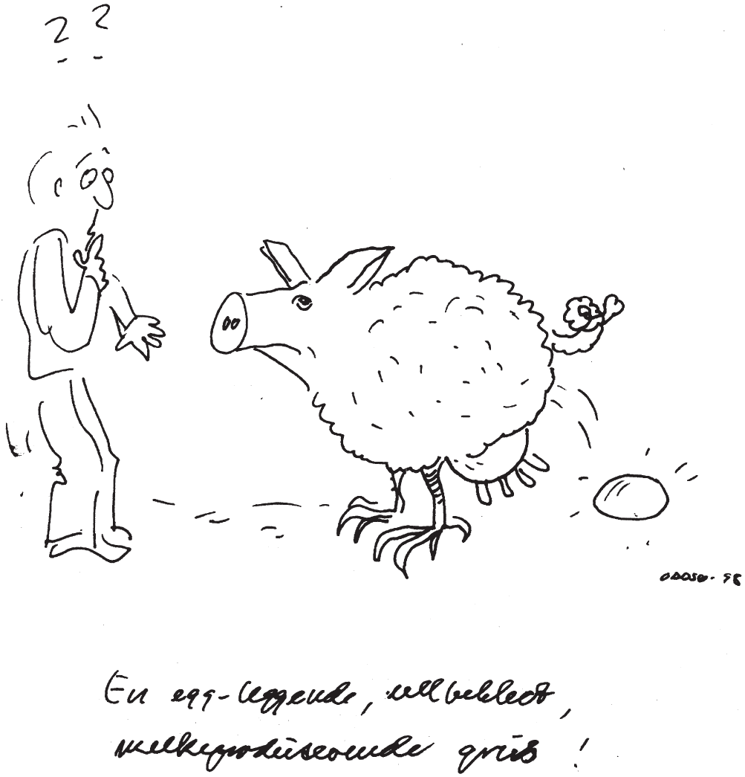
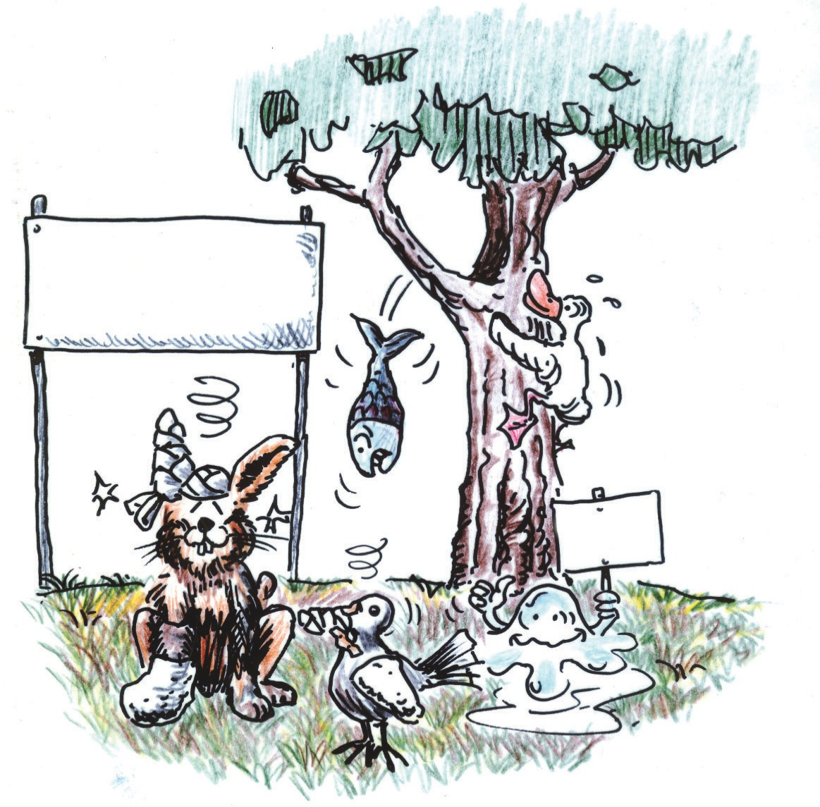
The two wings of capacity
The Animal School
Class Winner
Notes:
Pages 67-74 of The 3 Colors of Leadership contains the teaching associated with this slide.

Slide 23
The two wings of strategy
liberation
motivation
explanation
Teach the principles
Analyze present situation
Nurture steady progress
Assess weaknesses
Learn from mistakes
Analyze present situation
Set goals
Release vision of others
Cast a vision
Permit mistakes
Focus on strengths
Advocate bold moves
Set goals
Model the principles
Notes:
Pages 75-82 of The 3 Colors of Leadership contains the teaching associated with this slide.

Slide 24
The two wings of training
liberation
motivation
explanation
Teach the principles
Teach the principles
Analyze present situation
Nurture steady progress
Assess weaknesses
Learn from mistakes
Release vision of others
Cast a vision
Permit mistakes
Focus on strengths
Advocate bold moves
Set goals
Model the principles
Model the principles
Notes:
Pages 83-90 of The 3 Colors of Leadership contain the teaching associated with this slide.

Slide 25
The two wings of progression
liberation
motivation
explanation
Teach the principles
Analyze present situation
Nurture steady progress
Assess weaknesses
Learn from mistakes
Advocate bold moves
Nurture steady progress
Release vision of others
Cast a vision
Permit mistakes
Focus on strengths
Advocate bold moves
Set goals
Model the principles
Notes:
Pages 91-98 of The 3 Colors of Leadership contain the teaching associated with this slide.

Slide 26

What Spiritual Change Talk is all about
Experience
Do
Perceive
Test
Plan
Understand
transformation
application
information
Notes:
Pages 100-105 of The 3 Colors of Leadership contain the teaching associated with this slide.

Slide 27

What Spiritual Change Talk is all about
Notes:
Pages 100-105 of The 3 Colors of Leadership contain the teaching associated with this slide.

Slide 28
What Spiritual Change Talk is all about
Experience
Do
Perceive
Test
Plan
Understand
Experi-
mentation questions
Vision
questions
Capacity
questions
Trainee’s growth
Progression
questions
Strategy
questions
Training
questions
Notes:
Pages 100-105 of The 3 Colors of Leadership contain the teaching associated with this slide.

Slide 29
Vision questions
Experience
Do
Perceive
Test
Plan
Understand
Experi-
mentation questions
Vision
questions
Capacity
questions
Progression
questions
Strategy
questions
Training
questions
Notes:
Pages 106-111 of The 3 Colors of Leadership contain the teaching associated with this slide.

Slide 30
Experimentation questions
Experience
Do
Perceive
Test
Plan
Understand
Experi-
mentation questions
Vision
questions
Capacity
questions
Progression
questions
Strategy
questions
Training
questions
Notes:
Pages 112-117 of The 3 Colors of Leadership contain the teaching associated with this slide.

Slide 31
Capacity questions
Experience
Do
Perceive
Test
Plan
Understand
Experi-
mentation questions
Vision
questions
Capacity
questions
Progression
questions
Strategy
questions
Training
questions
Notes:
Pages 118-123 of The 3 Colors of Leadership contain the teaching associated with this slide.

Slide 32
Strategy questions
Experience
Do
Perceive
Test
Plan
Understand
Experi-
mentation questions
Vision
questions
Capacity
questions
Progression
questions
Strategy
questions
Training
questions
Notes:
Pages 124-129 of The 3 Colors of Leadership contain the teaching associated with this slide.

Slide 33
Training questions
Experience
Do
Perceive
Test
Plan
Understand
Experi-
mentation questions
Vision
questions
Capacity
questions
Progression
questions
Strategy
questions
Training
questions
Notes:
Pages 130-135 of The 3 Colors of Leadership contain the teaching associated with this slide.

Slide 34
Progression questions
Experience
Do
Perceive
Test
Plan
Understand
Experi-
mentation questions
Vision
questions
Capacity
questions
Progression
questions
Strategy
questions
Training
questions
Notes:
Pages 136-141 of The 3 Colors of Leadership contain the teaching associated with this slide.

Slide 35

Small group and larger group volume discounts apply on the book.
Or you can get started straight away by taking the online eTest.
See the web site for details.
Notes:
The cover of The 3 Colors of Leadership.

